Slide 1
Sales and Inventory Analysis
Impana P
July 2025

Slide 2

Introduction
The project explores sales and inventory data from a superstore.
Aims to identify revenue patterns, profit trends, and category-wise performance.
Useful for decision-makers in sales, marketing, and inventory control.
Helps uncover inefficiencies and product-level issues affecting profitability.
Supports strategic planning through data-driven visual insights.

Slide 3

Objective
Analyze monthly trends in sales and profit.
Identify top-performing and underperforming categories.
Evaluate product-level contribution to revenue.
Suggest improvements based on insights.

Slide 4
Project Workflow Overview
Introduction: Define project goals and business relevance.
Dataset Overview: Understand key features such as Category, Sub-Category, Sales, Profit, and Discount.
Data Cleaning: Remove duplicates, handle missing values, and format dates.
EDA (Exploratory Data Analysis): Explore distributions, correlations, and outliers.
Visualization & Insights: Generate and interpret visual trends across key dimensions.

Slide 5

Methodology
Tools & Libraries Used:
Google Colab – development environment
Python – a core programming language
Pandas – data manipulation and analysis
NumPy – numerical operations
Matplotlib & Seaborn – static visualizations
Plotly – interactive data visualizations

Slide 6
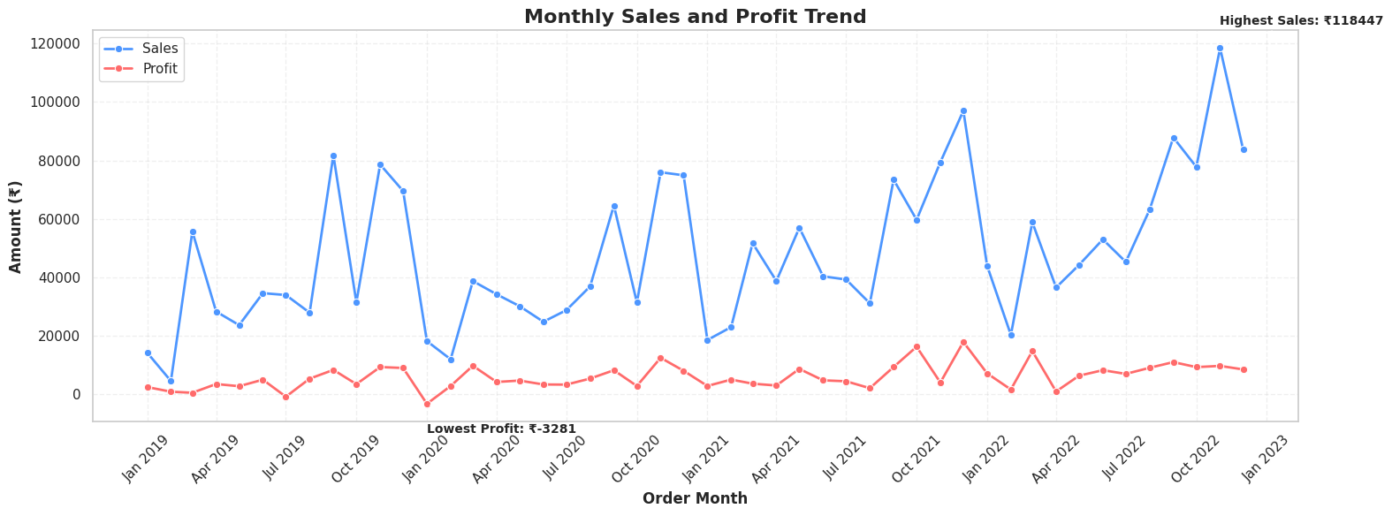
Monthly Sales and Profit Trend
Sales peaked in December; profits dipped in November.
Clear seasonal trends suggest a year-end push drives revenue.

Slide 7
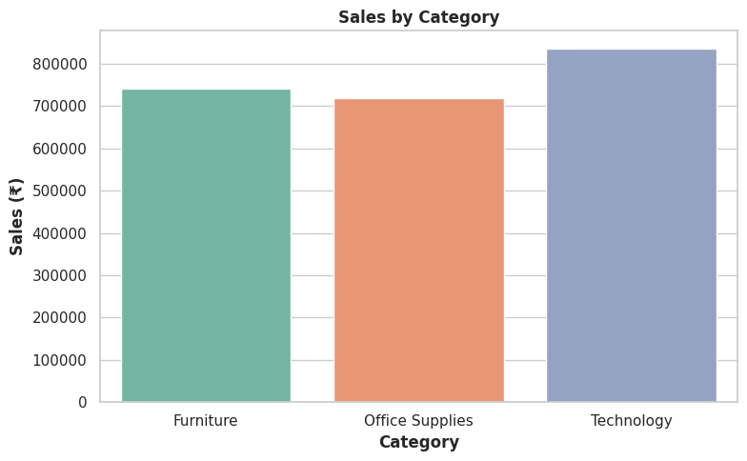
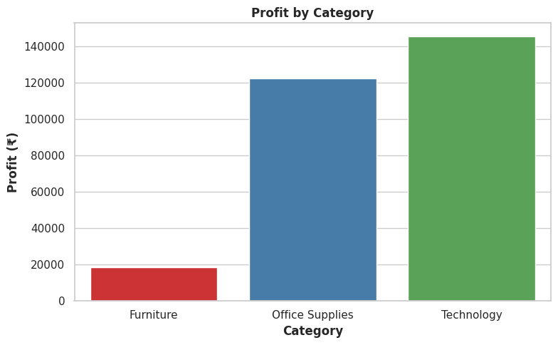
Sales & Profit by Category
Technology has the highest sales and profit.
Office Supplies performs well in profit despite lower sales.
Furniture has strong sales but contributes the least to profit.

Slide 8
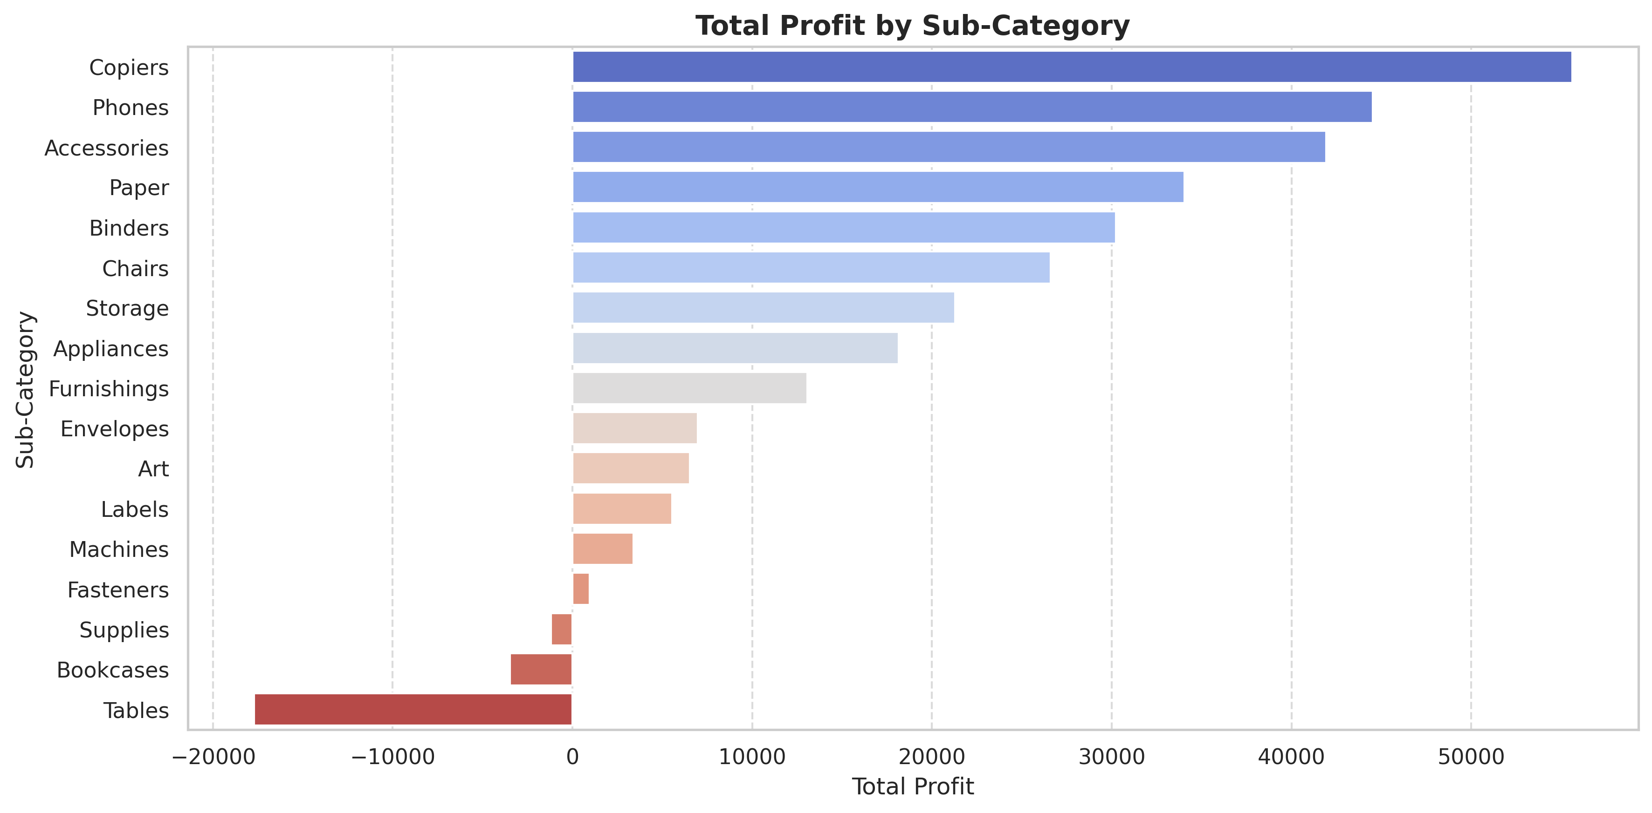
Sub-Category Profitability
Copiers and Phones are the most profitable.
Tables and Bookcases show negative or low profits.

Slide 9
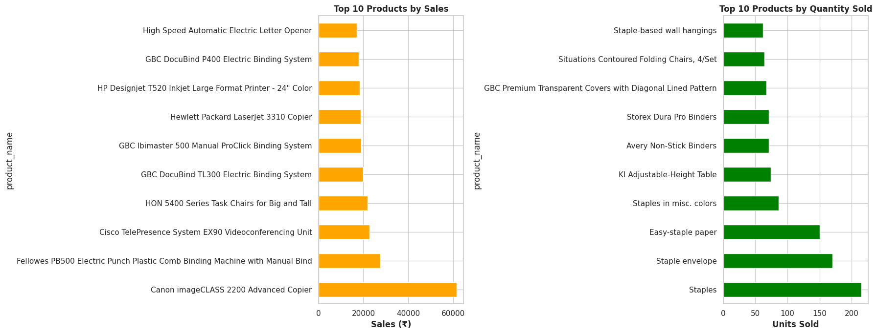
Top 10 Products by Sales & Quantity

Slide 10
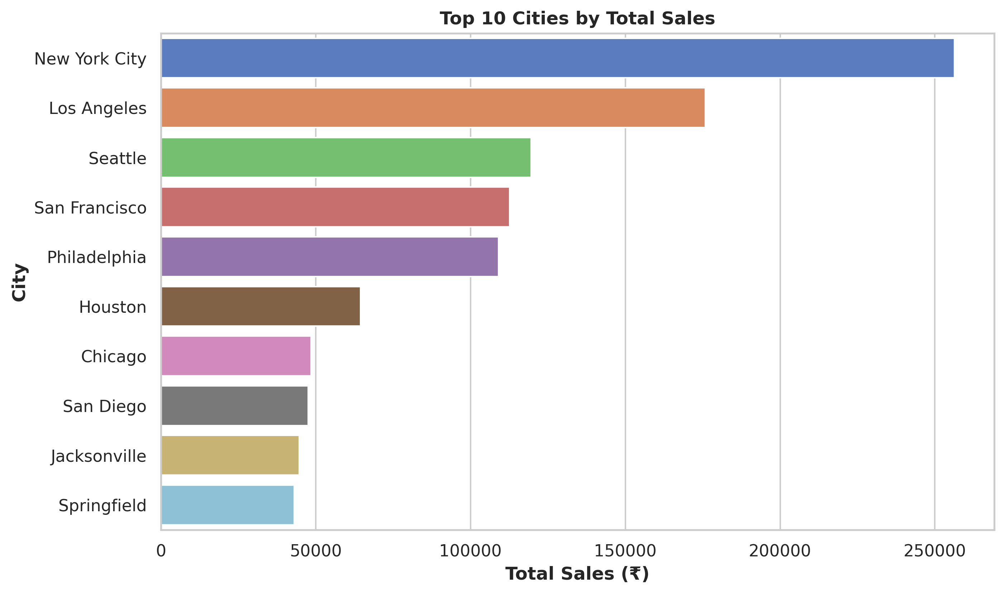
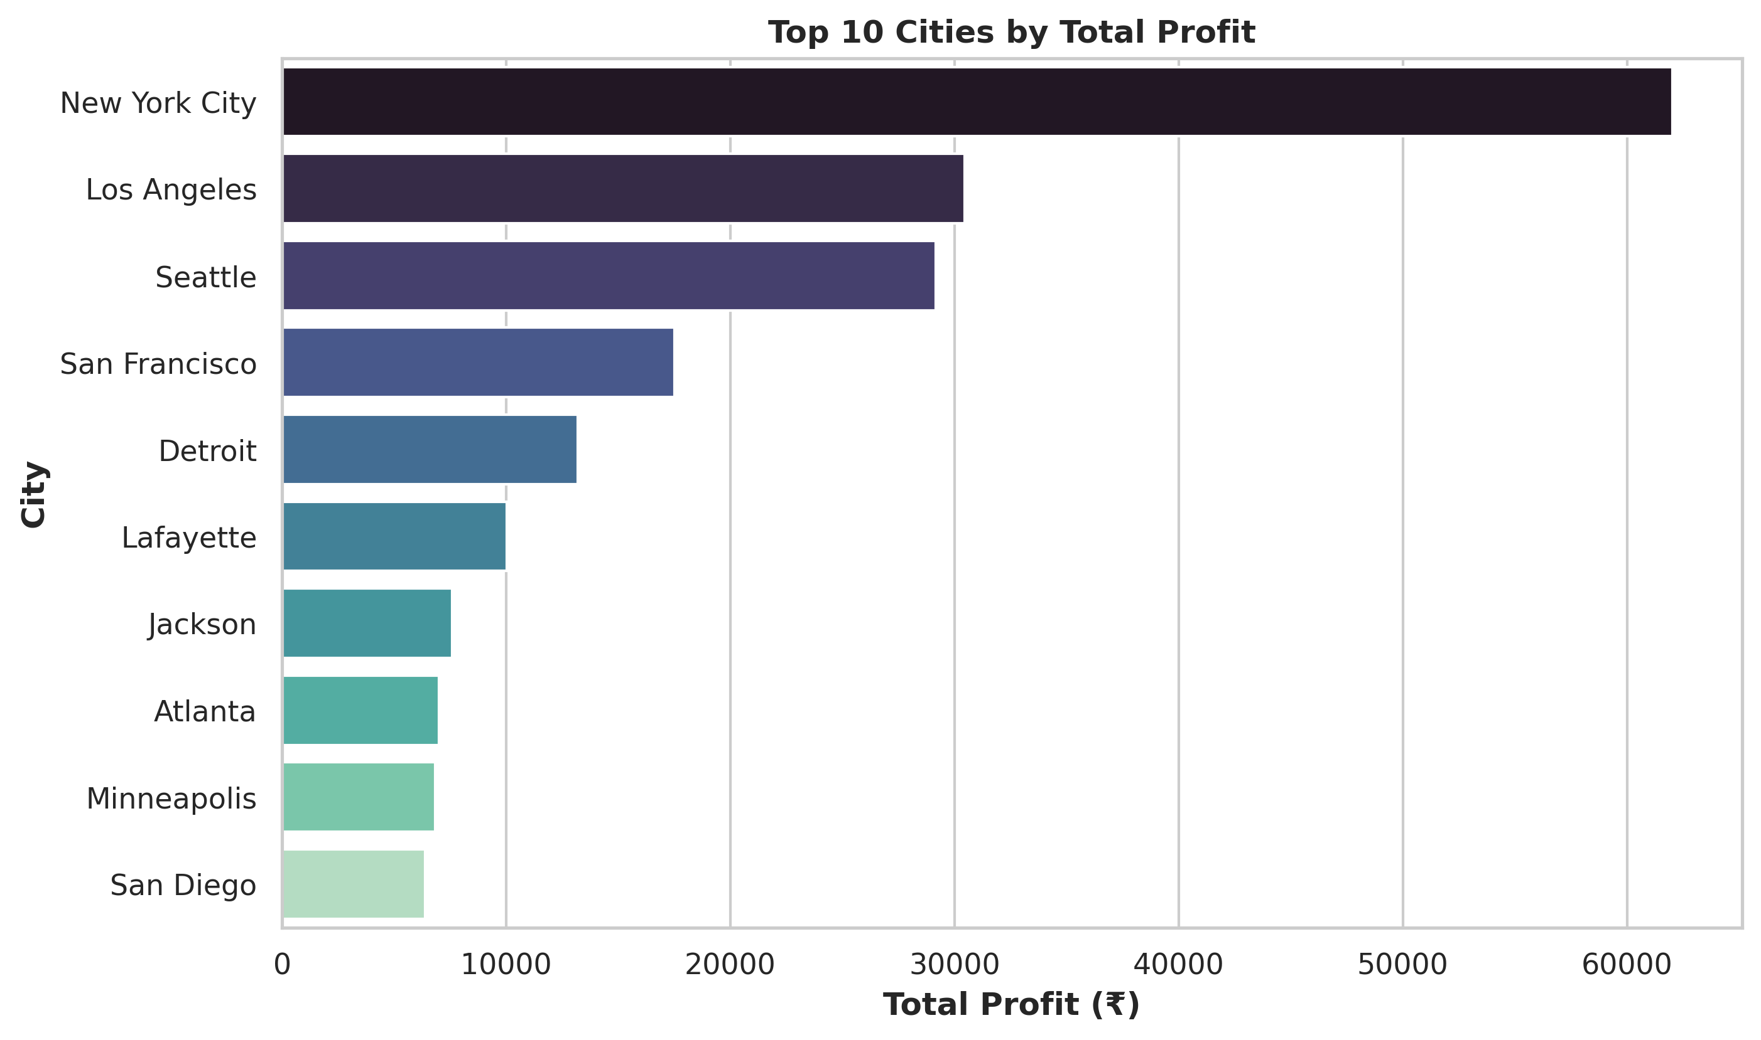
Top 10 Cities by Sales & Profit
Top 10 Cities by Sales:
New York, Los Angeles, and Seattle lead in sales.
These are likely major urban hubs with large order volumes.
Top 10 Cities by Profit:
New York, Detroit, and Lafayette show high profit
Suggests better margins or efficiency in those cities.

Slide 11
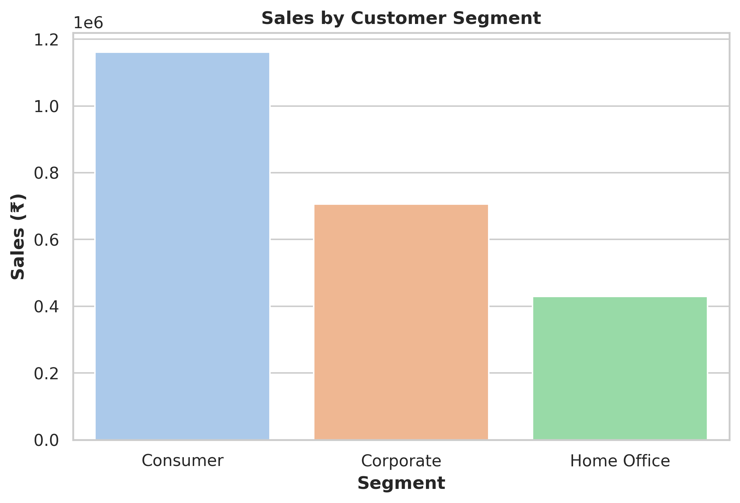
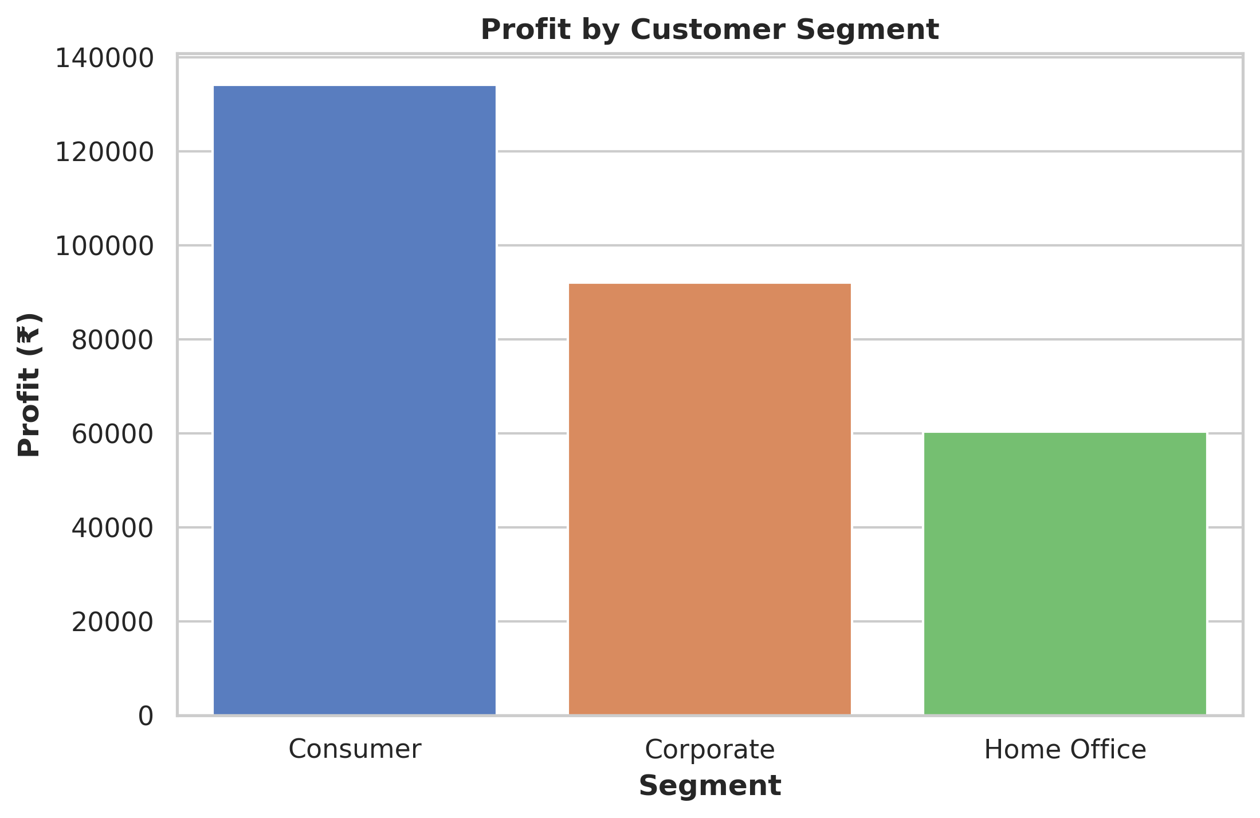
Sales and Profit by Customer Segment
Sales by Customer Segment
Consumer sales dominate, indicating strong demand in B2C.
Home Office lags, suggesting limited market reach or lower engagement.
Profit by Customer Segment
Highest profit from Consumer shows better margins or volume.
Low Home Office profit may signal inefficiencies or pricing issues.

Slide 12
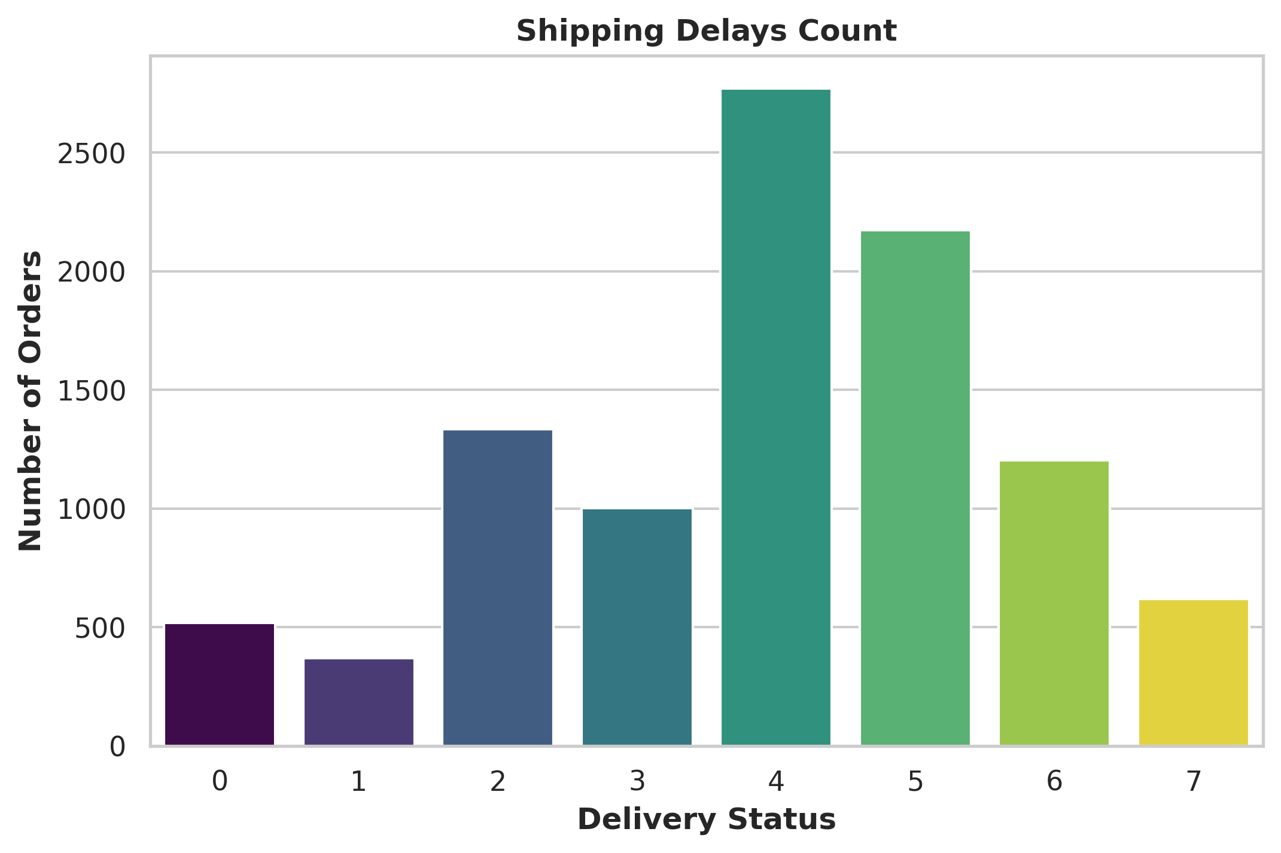
Order Distribution by Shipping Delay Status
Shipping Delays Count:
Most orders fall under delay statuses 4 and 5, indicating frequent mid-level delays.
Very few orders are at extreme delay levels (0, 1, or 7), suggesting rare severe issues.
Focus on improving the delivery process around status 4–5 to reduce the bulk of delays.

Slide 13
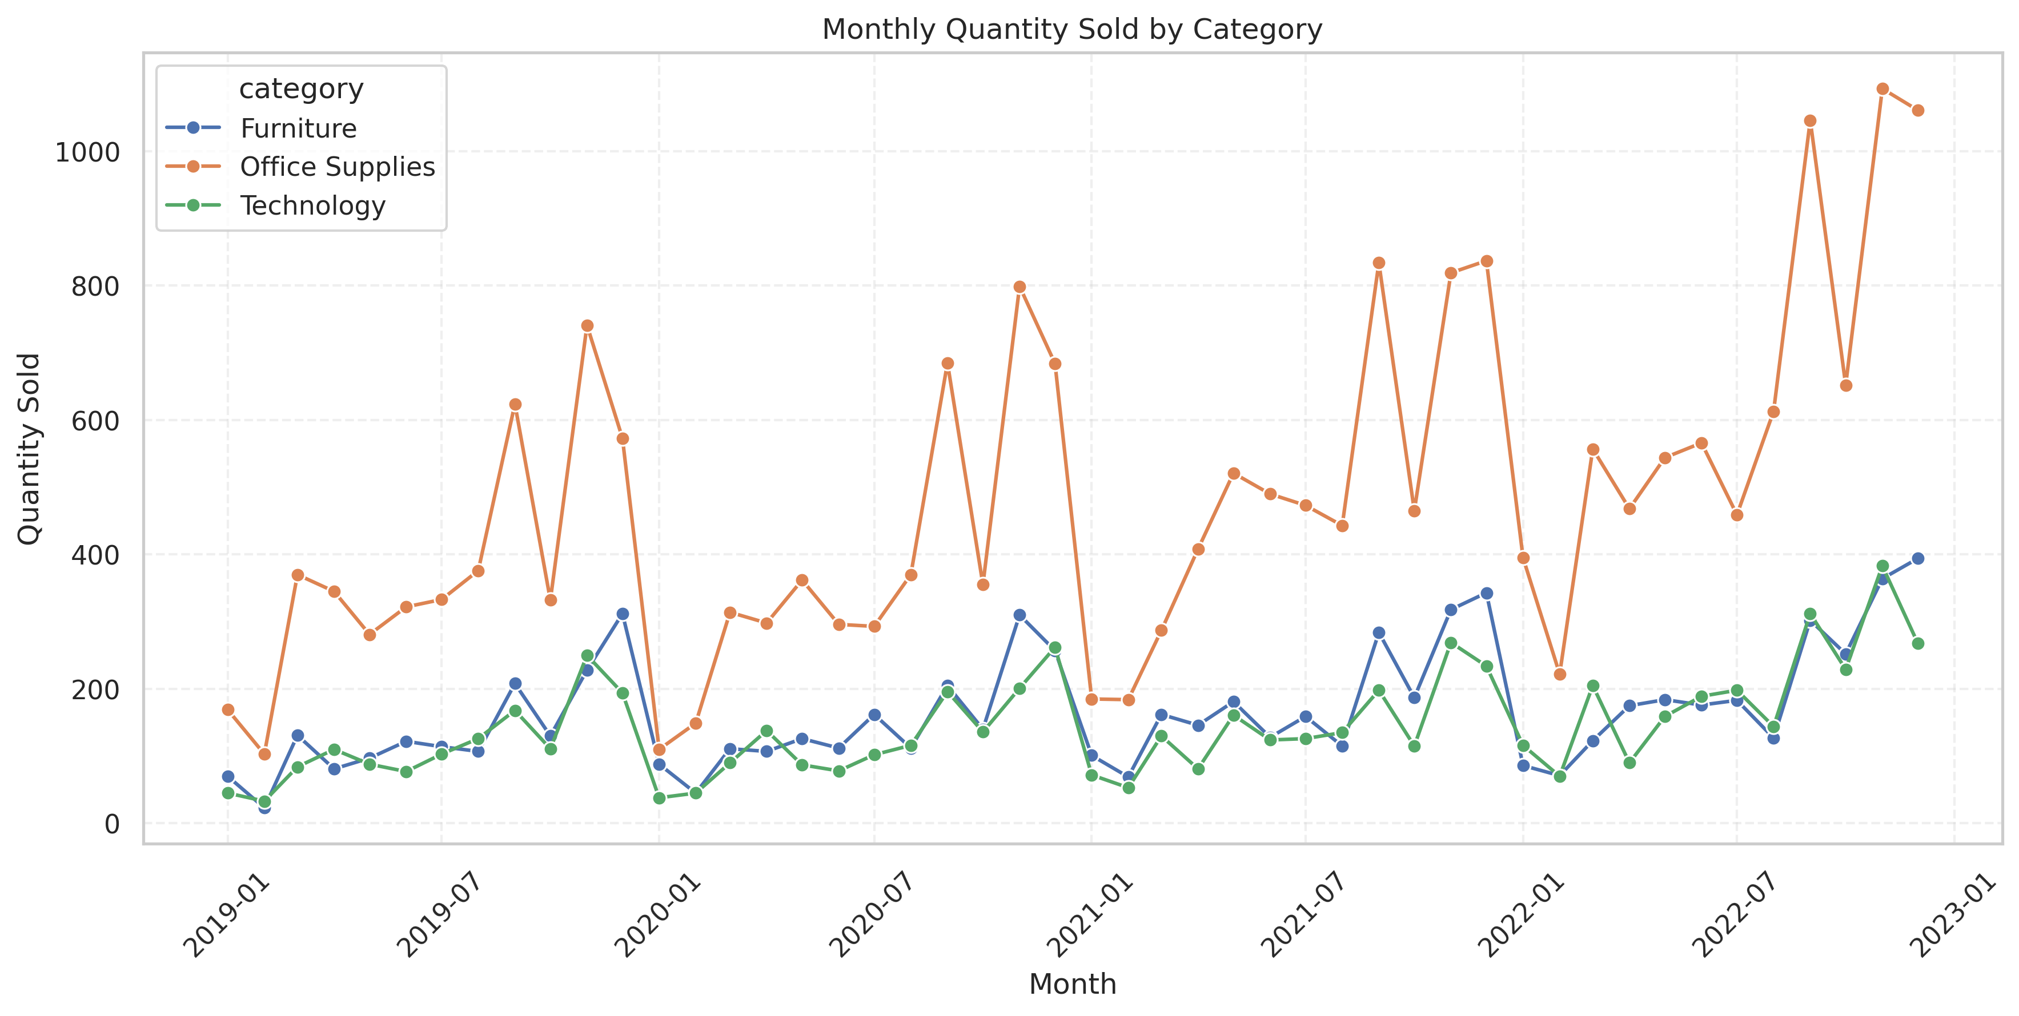
Monthly Quantity Trends by Product Category

Slide 14
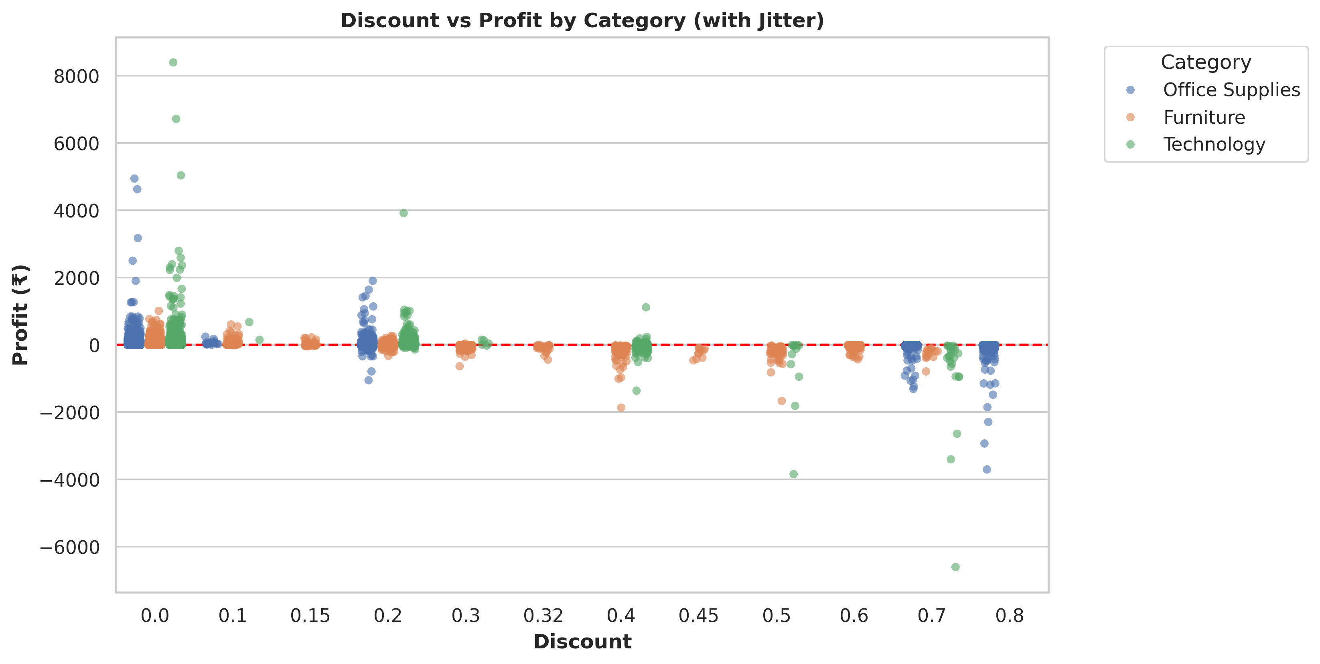
Discount vs Profit by Category
Profit declines noticeably as discount levels increase
Discounts above 20–30% often lead to negative profit
Furniture and Office Supplies are more affected by discounting losses
Highlights the need for a smarter discount strategy to protect margins

Slide 15
Final Conclusion
Technology leads in both sales and profit
Binders and Paper sell most but don’t always generate profit
Tables and Bookcases are consistent loss-makers
Copiers yield the highest profit among all sub-categories
New York and LA dominate revenue; Detroit is highly profitable
Consumer segment performs best
Discounts beyond 30% often cut into profit
Align pricing, inventory, and discounting for better margin control

Slide 16
Business Recommendations
Focus on the Technology category, as it consistently leads in both sales and profit, ideal for marketing and upselling strategies.
Re-evaluate Furniture and Bookcases, which generate strong sales but show low or negative profits - consider pricing or cost optimization.
Restrict high discounts, especially above 30%, as they significantly reduce profits in categories like Furniture and Office Supplies.
Strengthen Consumer segment engagement, as it delivers the highest sales and profit, ideal for targeted promotions.
Improve performance in the Home Office segment, which lags in both revenue and profit - assess pricing, targeting, or product mix.
Optimize delivery processes, especially for orders with delay status 4 and 5 — most delays fall in this range and can impact customer satisfaction.
Double down on high-performing cities like New York, Los Angeles, and Detroit — they offer high revenue and profitability, showing strong market potential.
Monitor loss-making sub-categories such as Tables and Binders — evaluate whether to improve margins, adjust prices, or limit inventory.

Slide 17

Thank you
Impana P
impana.panu@gmail.com
www.linkedin.com/in/impana-p-011131260

